Slide 1

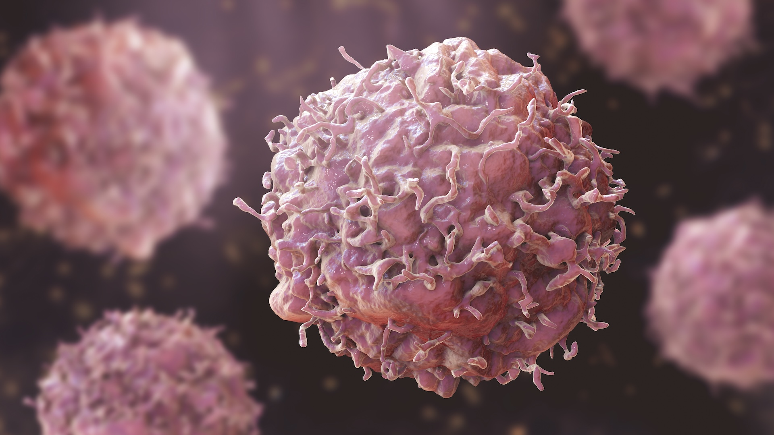


MathRi Team
ACID-MEDIATED TUMOR GROWTH

Slide 2


Why Cancer Invasion?
Tumor invasion is a key step in cancer progression.
Existing models often ignore the tumor microenvironment.
Authors propose a simple, testable hypothesis:
“Acid produced by tumor cells changes the pH, making surrounding tissue uninhabitable for healthy cells.”
A Reaction-Diffusion Model of Cancer Invasion” by Gatenby & Gawlinski (1996)

Slide 3

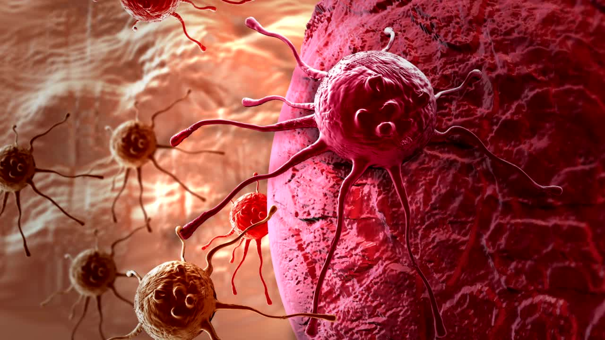
Acid-Mediation Hypothesis
TUMOR CELLS RELY ON GLYCOLYSIS, PRODUCING EXCESS H⁺ IONS
01
THESE IONS DIFFUSE OUTWARD, LOWERING PH IN SURROUNDING TISSUE.
02
NORMAL CELLS DIE IN ACIDIC PH (~PH < 7.1), WHILE TUMOR CELLS THRIVE (OPTIMAL ~PH 6.8).
03

Slide 4
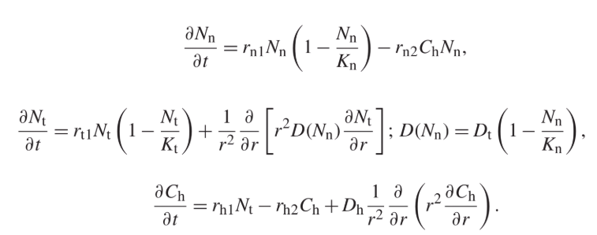
PDE System for Acid-Mediated
Tumor Growth
Each equation describes the time and space evolution of:
Nn(r,t): Normal cell density
Nt(r,t): Tumor cell density
Ch(r,t): Excess hydrogen ion concentration (acidity)
Schiesser, W. E. (2013). Partial Differential Equation Analysis in Biomedical Engineering. Cambridge University Press.

Slide 5
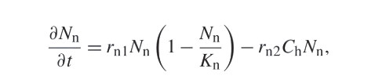
PDE System for Acid-Mediated
Tumor Growth
Normal Cells Equation
Describes how healthy cells grow and die
First term: Represents the logistic growth of normal cells, limited by a carrying capacity Kn​.
Second term: a death term due to acid-induced damage from tumor-released H⁺ ions.
The equation is nonlinear due to the product of variables.

Slide 6
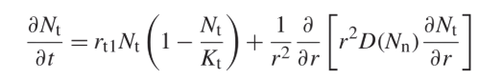
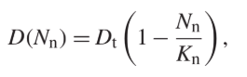
PDE System for Acid-Mediated
Tumor Growth
Tumor Cells Equation
Describes how tumor cells grow and spread in tissue.
First term: Logistic growth limited by carrying capacity Kt​.
Second term: Diffusion, with spreading influenced by local normal cell density D(Nn).
Nonlinear due to both logistic term and variable diffusivity.

Slide 7
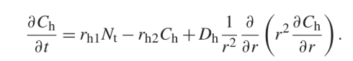
PDE System for Acid-Mediated
Tumor Growth
Acid Concentration Equation
Describes how acid is produced, removed, and spreads in tissue.
First term: Acid produced by tumor cells.
Second term: Natural decay or removal of acid.
Third term: Diffusion of acid through tissue.
Appears linear in form, but part of a nonlinear system due to coupling.

Slide 8
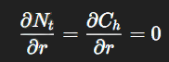
PDE System for Acid-Mediated
Tumor Growth
Initial and Boundary Conditions
Boundary Conditions:
Homogeneous Neumann (zero-flux) conditions at r=0 and r=R:
Ensure no artificial flow of cells or acid across boundaries.
Preserve spherical symmetry of the model domain.
Initial Conditions:
Define starting values for all variables:
Nn(r,0): Normal cells
Nt(r,0): Tumor cells
Ch(r,0): Acid concentration
Smooth tanh-based profiles used for biological realism and numerical stability.

Slide 9
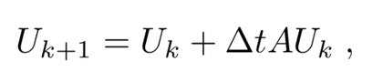
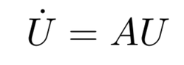
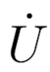
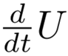
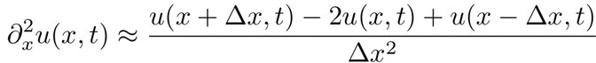
Method of line
(MOL)
The method of lines replaces a PDE for the evolution in time of a function of x with an ODE system for a discrete (in space) approximation. The method of lines leads to the problem of solving (large) ODE systems.
2. System now is Transformed into
where A is the matrix representing the finite difference approximation
3. solving the system
Where is the , system of ODEs that can be solved using high-order ODE solvers like Runge-Kutta methods
First, we discretize the spatial domain using numerical approximation (e.g, Centered Finite Difference)

Slide 10
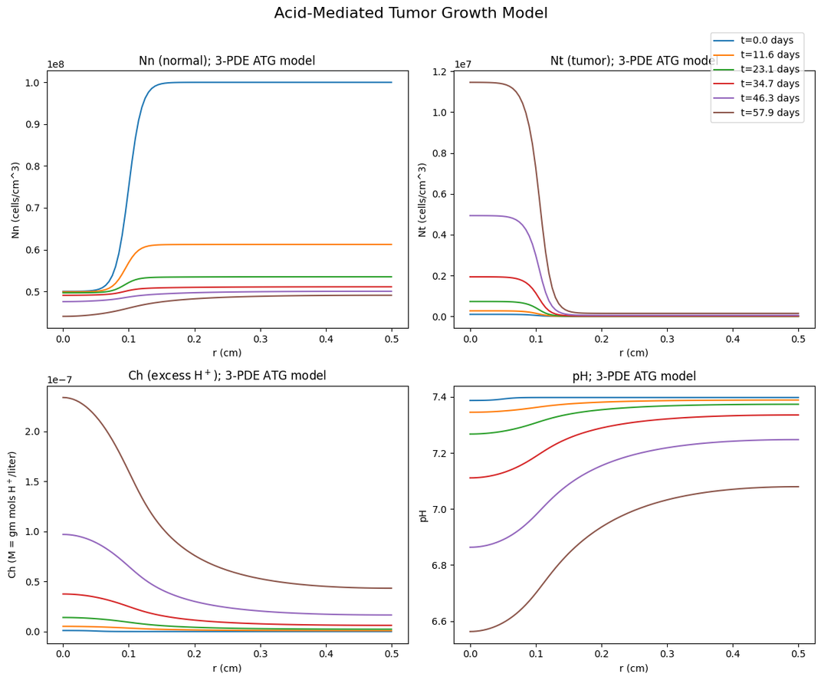
Results

Slide 11
FEM is a numerical method that solves complex differential equations by dividing a domain into smaller parts (elements) and approximating the solution over each element.
🔹 Handles irregular shapes and complex boundaries
🔹 Transforms PDEs into solvable algebraic systems
Finite Element Method

Slide 12
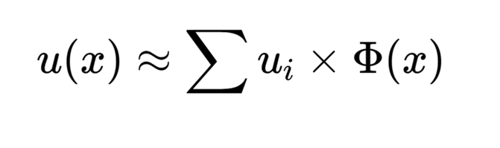
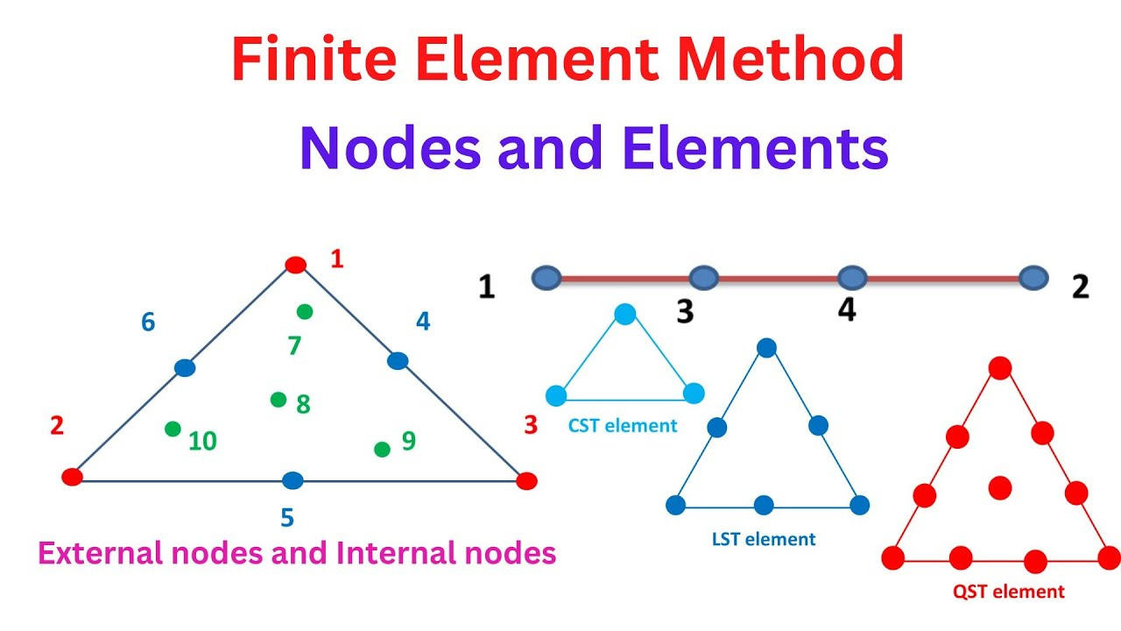
FEM workflow
Domain
DIscretization
Nodes and Elements
Weak
Formulation
Multiply PDE by test function and integrate

Slide 13
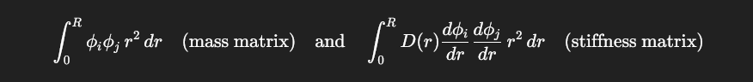
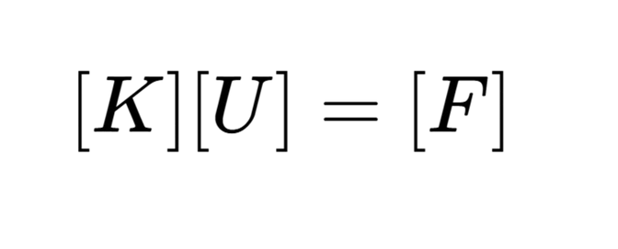
FEM workflow
Element Assembly and application of BC’S
Solve linear system using LU decomposition

Slide 14
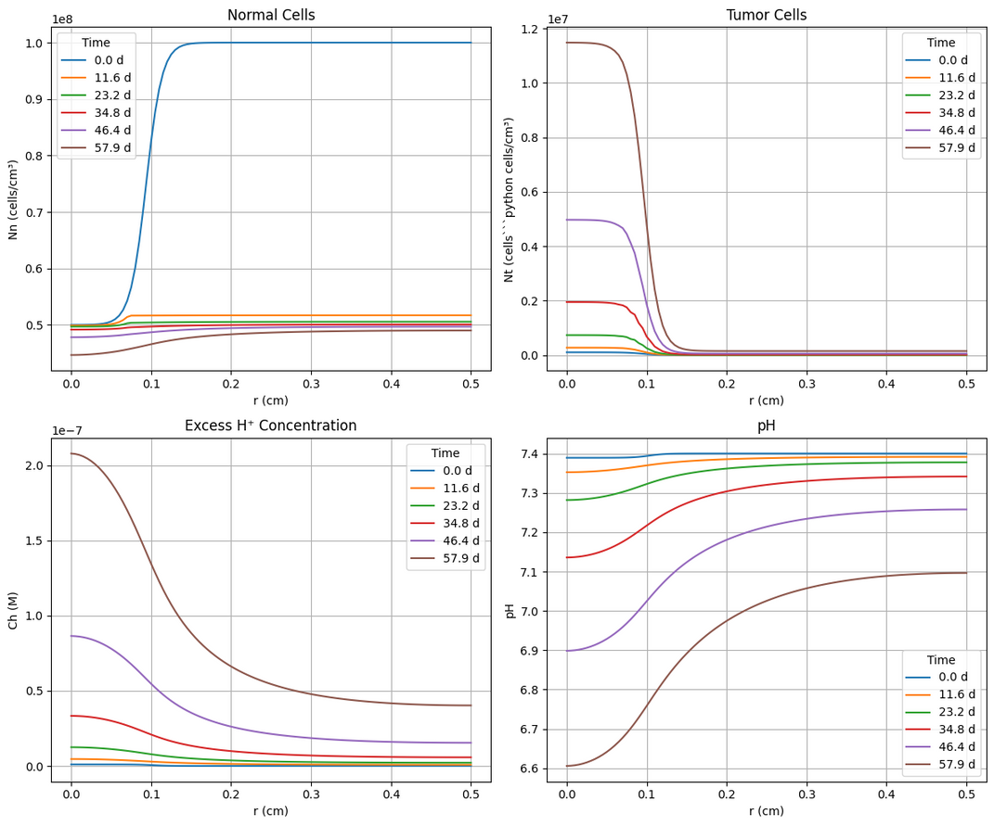
Finite Element Method Results
Similar trend to MOL
Can we consider this an acceptable solution?

Slide 15
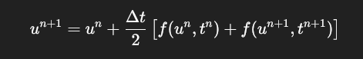
Crank-Nicholson Method
Definition
Key characteristics
A numerical technique for solving time-dependent partial differential equations.
It works by averaging the results of the forward and backward Euler methods
Unconditionally Stable
Second order accuracy in time
Implicit in nature

Slide 16
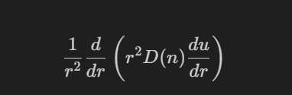
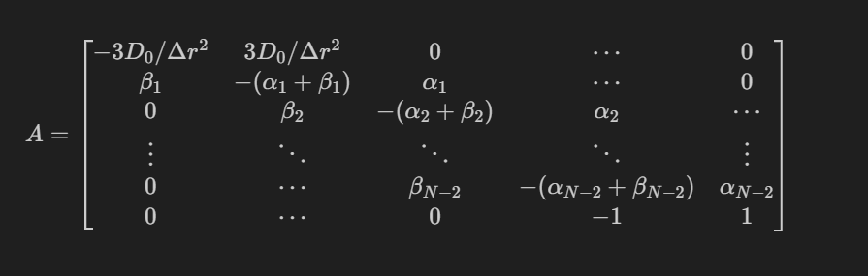
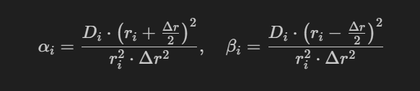
Crank-Nicholson Method
Approaching spherical coordinates
Discretize radial diffusion operator
Obtain Tridiagonal matrix
FVM (shell)

Slide 17
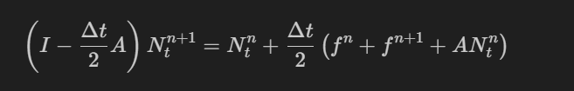
Crank-Nicholson Method
Approaching spherical coordinates
Time Stepping
Tumor cell/Excess lactic acid update
Normal cell update
We use an explicit predictor-corrector approach:
1. Predict with forward Euler
2. Correct with trapezoidal averaging

Slide 18
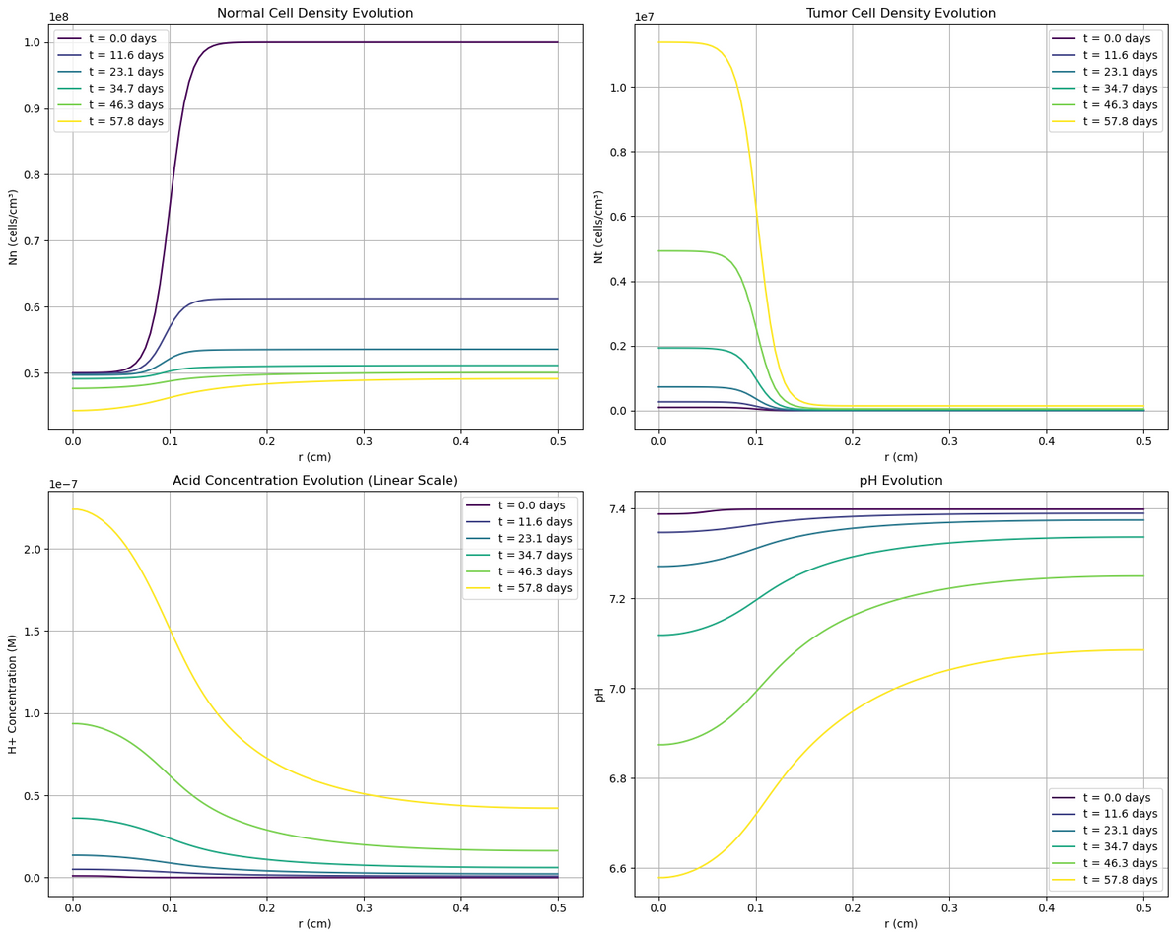
Crank-Nicholson Method
Results
Very similar results to MOL
Follows an identical trend to MOL

Slide 19
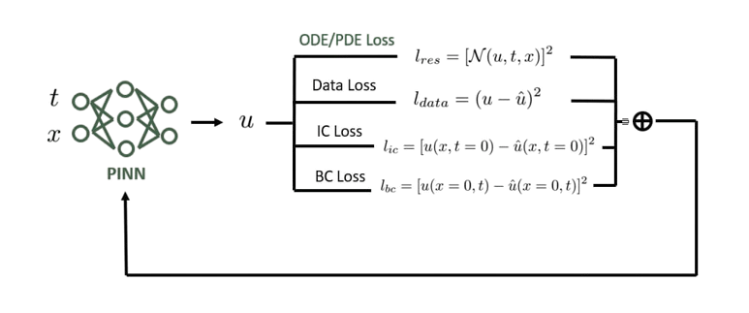

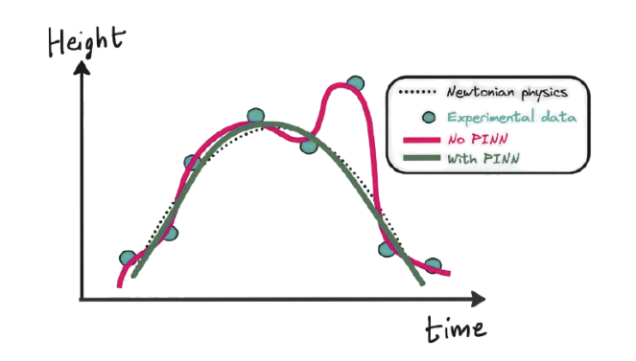
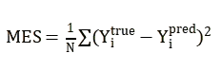
Why Use PINNs Instead of
Traditional Methods?
PINN VS No-PINN
Loss FUNCTION

Slide 20

PINN code workflow
Initialize Model Parameters
Generate Initial Conditions
Numerical Solver Execution
Save Data in CSV
PINN Architecture Setup
Loss Function Construction
Training Process
Evaluation & Visualization

Slide 21
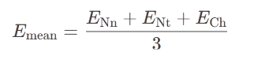
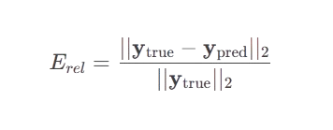
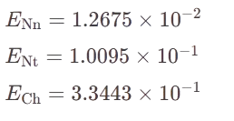
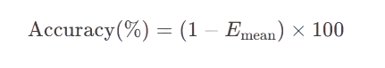
Results of our PINN model
Mean Relative error
Relative Error
Mean Error=14.94%
Accuracy
Mean error
Accuracy= 85.06%

Slide 22
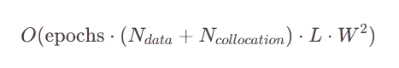
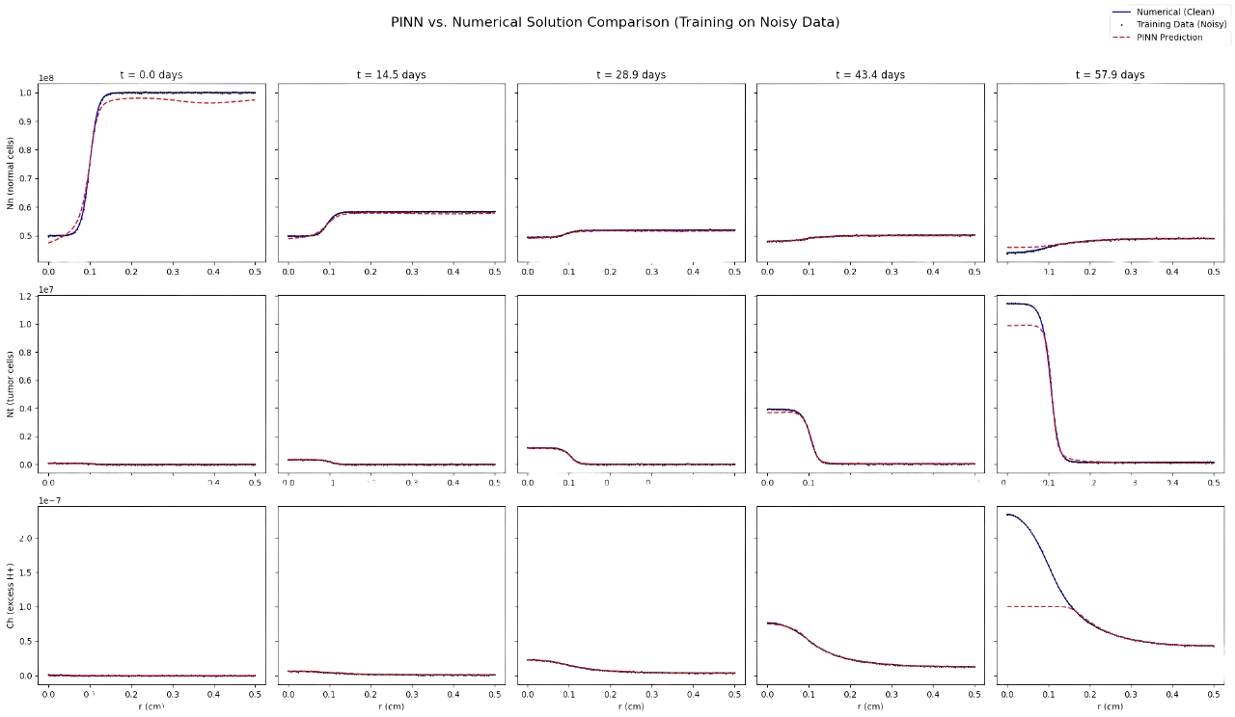
RESULTS OF OUR PINN MODEL
Time Complexity
Where:
epochs =10,000
N_data = n* nout = 2,121 points
N_collocation =2,000 points
L= 3 layers
W =80 neurons

Slide 23
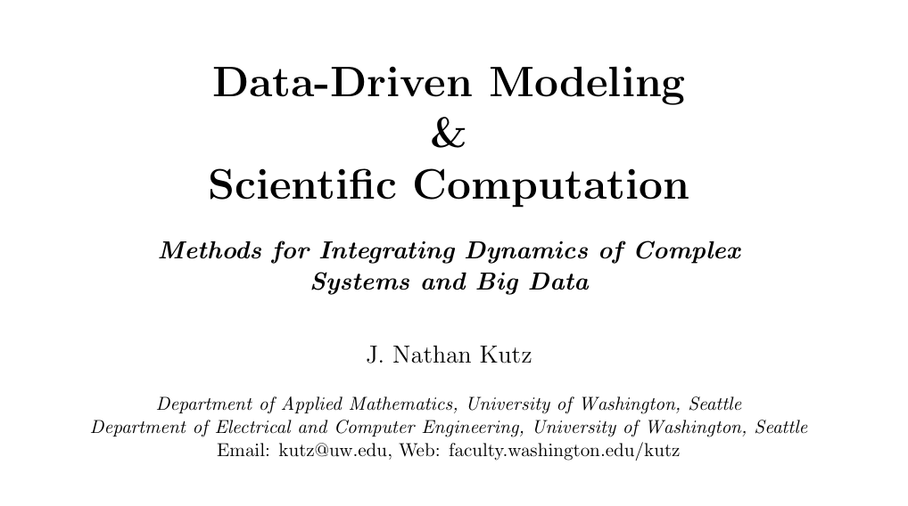
Spectral Method
Chebychev Colocated Method
https://faculty.washington.edu/kutz/kutz_book_v2.pdf
J. N. Kutz, Data-Driven Modeling & Scientific Computation: Methods for Complex Systems & Big Data. Oxford: Oxford University Press, 2013.

Slide 24
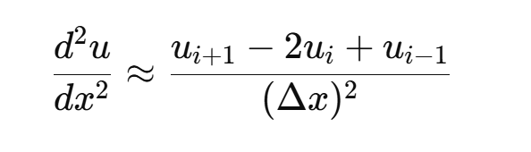
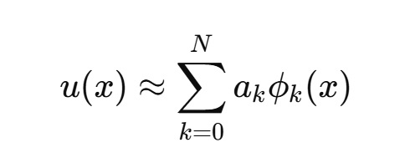
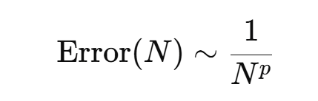
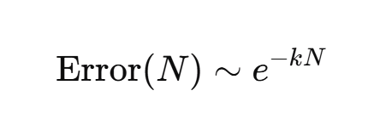
Why Spectral Methods?
Finite Difference Methods
Spectral
Local domain
Uses a few neighbouring grid points.
Problems with non-smooth or complex geomtries.
Global Domain
Uses all points to estimate the derivative
Problems with Smooth Solution
Spectral Accuracy

Slide 25
Why Chebychev Collocation Method?
The book mainly discusses the implementation of
Fourier Spectral Methods
Pseudo-Spectral Methods with FFT
Chebychev Spectral Methods
Floquiet-Fourier-Hill Method
Fourier-based spectral methods should be avoided as the solution is not periodic as seen in the results of the MOL method.

Slide 26
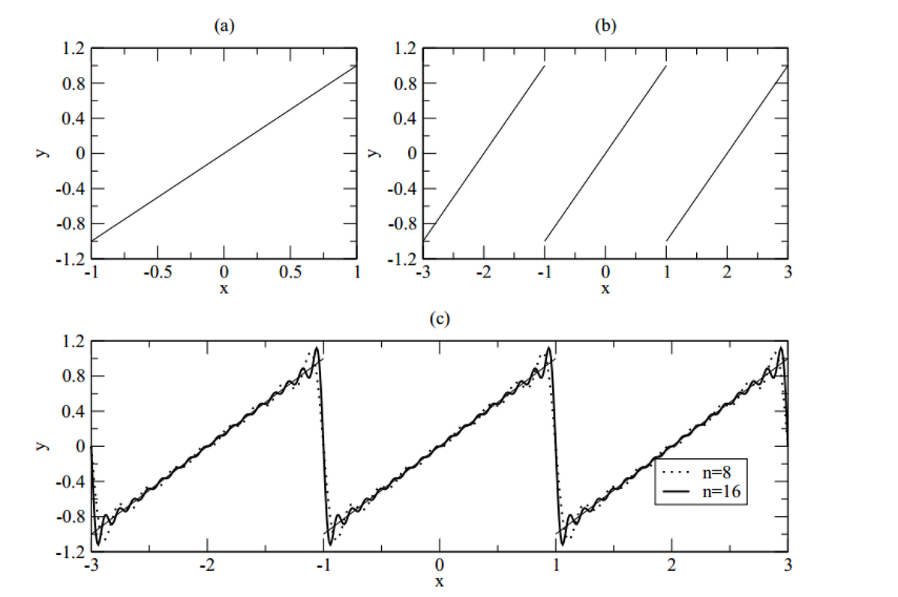
Chebychev Collocation Method
1. Periodic Extension
Introduces Gibbs Oscillations

Slide 27
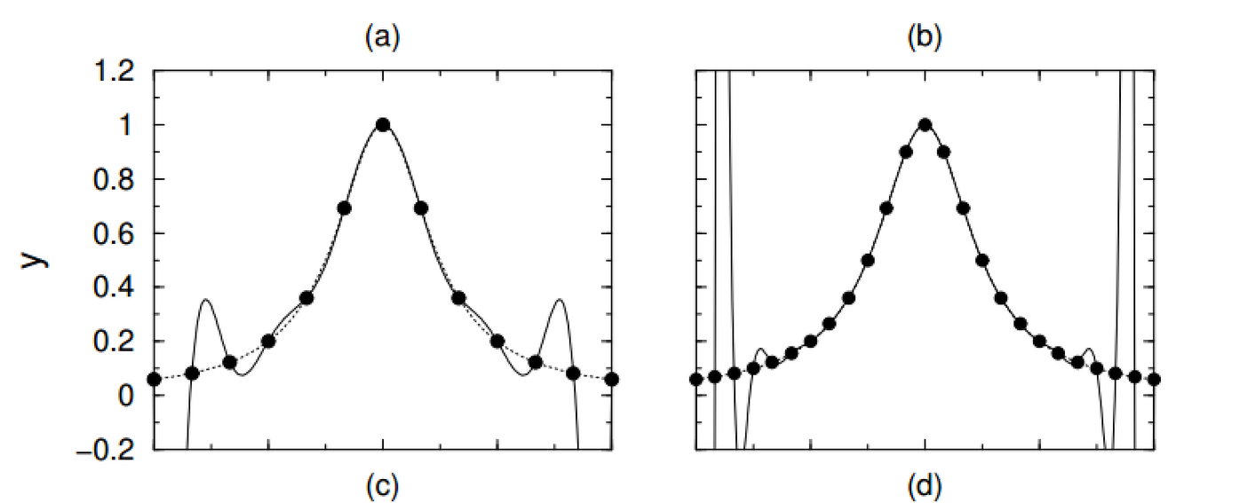
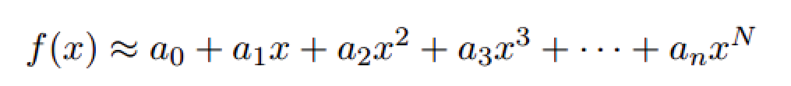
Chebychev Collocation Method
2. Polynomial with equidistant points
Introduces Gibbs Oscillations

Slide 28
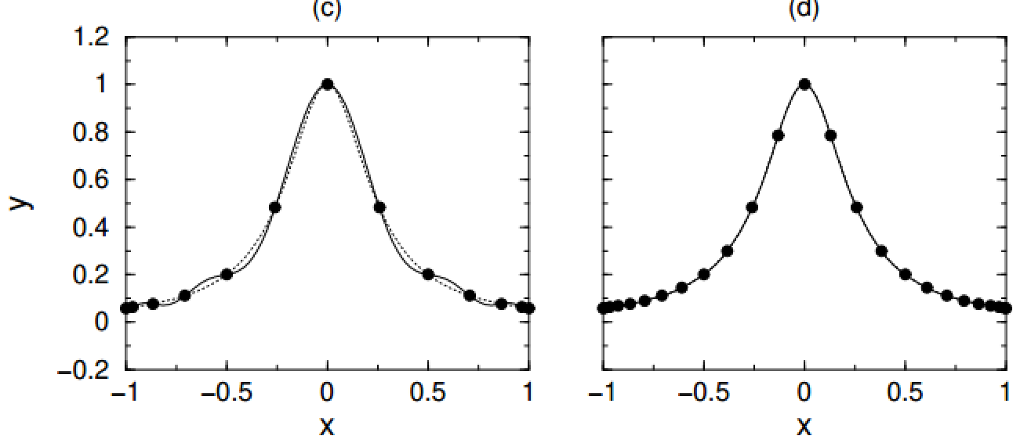
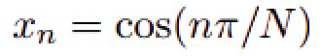
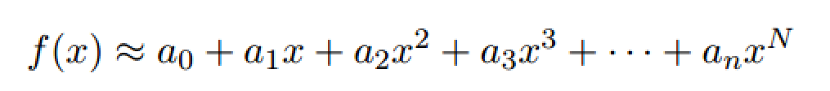
Chebychev Collocation Method
3. Polynomial approximation with clustered points
Nth degree Polynomial
requires N+1 Points
Reduces Runge Phenomena

Slide 29
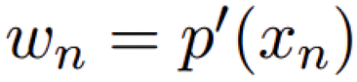
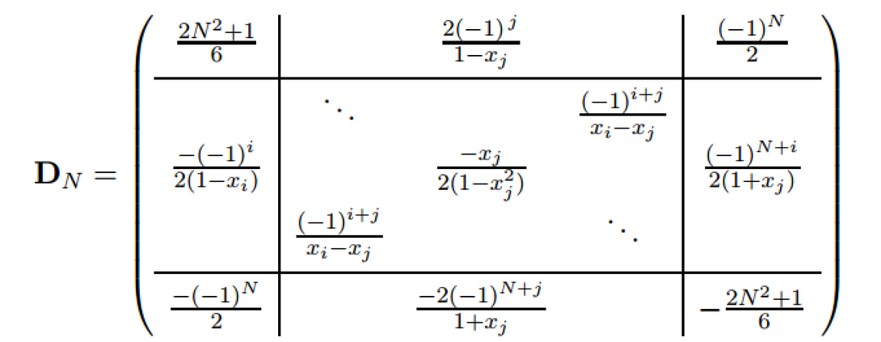
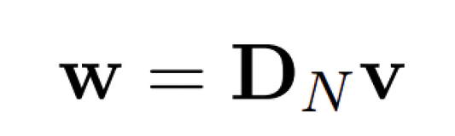
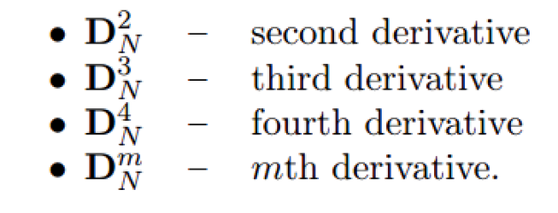
Chebychev Collocation Method
Algorithm to construct the polynomial and its derivative
Assume P is the polynimial , V(x) is the true function and W be the derivative.
Assuming a grid of chebychev points

Slide 30
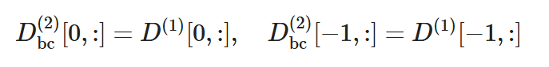
Chebychev Collocation Method
Neuman Boundary Condition
Instead of using the standard Chebyshev second derivative matrix as-is, we modify it by replacing its first and last rows with the corresponding rows from the first derivative matrix to enforce Neumann boundary conditions.

Slide 31


Chebychev Collocation Method
Solved with Backward differentiation method
“SOLVE_IVP,” solve_ivp - SciPy v1.15.3 Manual, https://docs.scipy.org/doc/scipy/reference/generated/scipy.integrate.solve_ivp.html (accessed Jun. 20, 2025).

Slide 32


Chebychev Collocation Method
Results and Time Complexity
“SOLVE_IVP,” solve_ivp - SciPy v1.15.3 Manual, https://docs.scipy.org/doc/scipy/reference/generated/scipy.integrate.solve_ivp.html (accessed Jun. 20, 2025).

Slide 33



FROM 3-EQUATION SYSTEM → TO 2 EQUATIONS → TO 1 DEGENERATE PDE
MOTIVATED BY COMPUTATIONAL SIMPLICITY AND SIMPLIFICATION TO GET AN ANALYTICAL SOLUTION IN A SPECIAL CASE
2 EQUATION MODEL
Literature Review
C. Mascia, P. Moschetta, and C. Simeoni, “Numerical investigation of some reductions for the gatenby–gawlinski model,” Axioms, vol. 13, no. 5, p. 281, Apr. 2024. doi:10.3390/axioms13050281

Slide 34


FROM 3-EQUATION SYSTEM → TO 2 EQUATIONS → TO 1 DEGENERATE PDE
MOTIVATED BY COMPUTATIONAL SIMPLICITY AND BETTER ANALYTICAL TRACTABILITY
1 EQUATION MODEL
Literature Review
DEGENERATIVE DIFFUSION TERM

Slide 35


FROM 3-EQUATION SYSTEM → TO 2 EQUATIONS → TO 1 DEGENERATE PDE
MOTIVATED BY COMPUTATIONAL SIMPLICITY AND BETTER ANALYTICAL TRACTABILITY
Literature Review

Slide 36

FROM 3-EQUATION SYSTEM → TO 2 EQUATIONS → TO 1 DEGENERATE PDE
MOTIVATED BY COMPUTATIONAL SIMPLICITY AND BETTER ANALYTICAL TRACTABILITY
Literature Review

Slide 37



Future Work
SHARPER INTERFACES
HIGHER-DIMENSIONAL MODELING
PATIENT-SPECIFIC MODELING
Capturing fine tumor-host transitions to improve spatial resolution.
From radial models to realistic tumor shapes.
Linking the model with clinical data for personalization.

Slide 38

Conclusion

Slide 39
THANK YOU!!!
AYA AHMED FAROUK
MO’MEN MOHAMED YEHIA
MONA AHMED MOHAMED
MOSTAFA KHALED ELSAYED
RAGHAD ABDELHAMEED
RAWAN MOHAMED NASR
YOUSSEF DAOUD WILLIAM
YOUSSEF MOHAMED WANIS

